Slide 1
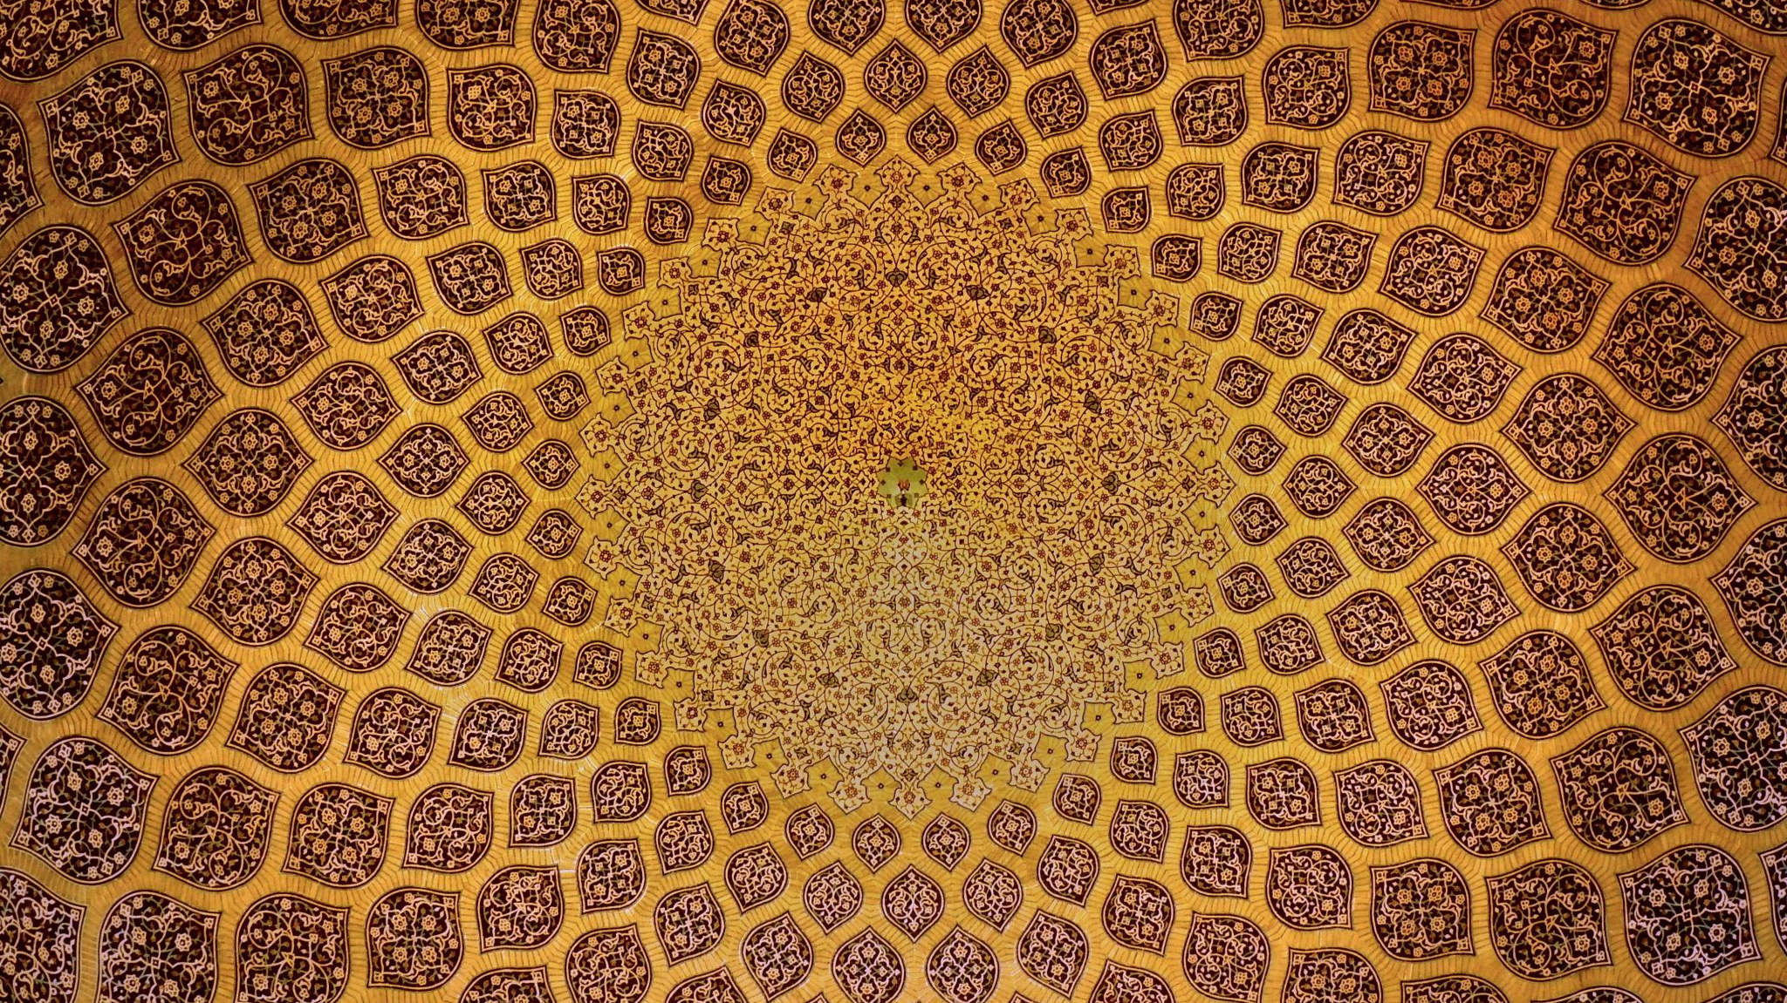
Heritage - إرث
Reviving the Voices of Arabic Heritage through Character Simulation

Slide 2
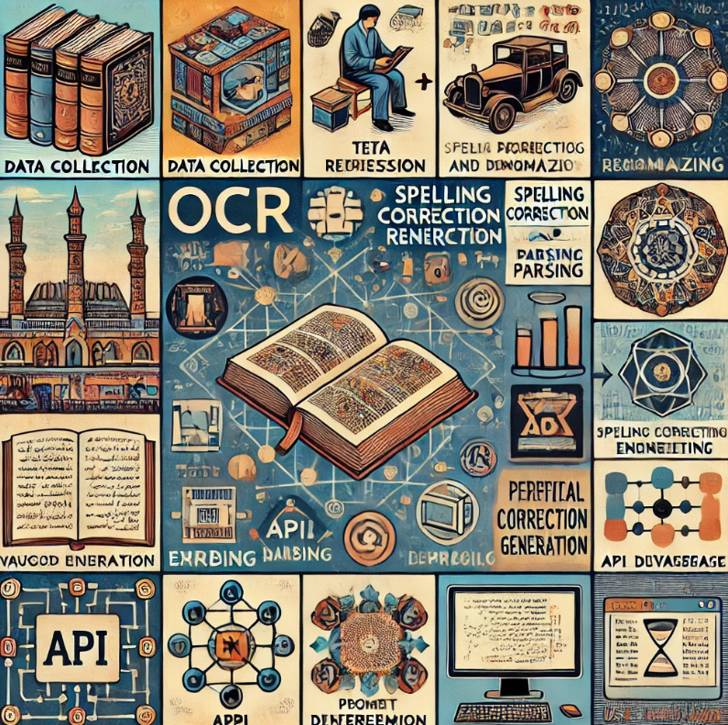
Project Workflow Overview
Data Collection
OCR (Optical Character Recognition)
Text Processing
Spelling Correction and Parsing
Embedding
Vector Database
Prompt Engineering
Retrieval-Augmented Generation (RAG)
API Development
User Interface (UI)

Slide 3

Data Collection
Data Collection involves gathering, cleaning, and structuring historical data from trusted sources to ensure accuracy and authenticity.

Slide 4

OCR (Optical Character Recognition)
Converts scanned Arabic texts into machine-readable formats, enabling further processing and analysis.

Slide 5
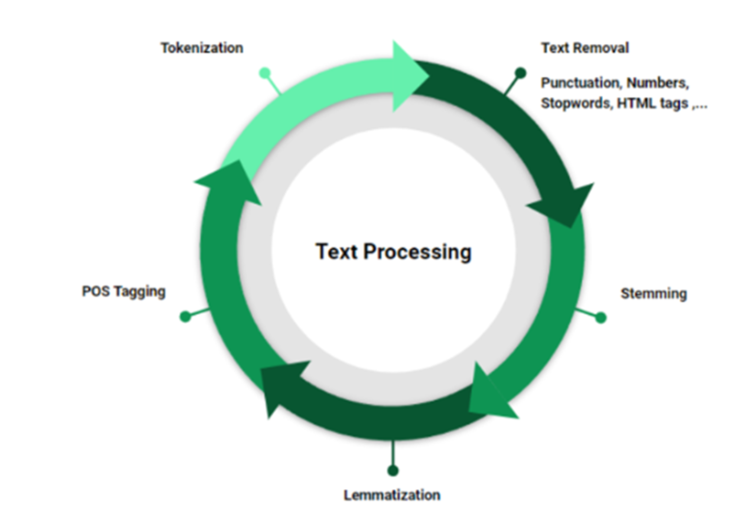
Text Processing
Cleans, normalizes, and prepares OCR output, making the text ready for advanced analysis and embedding.

Slide 6
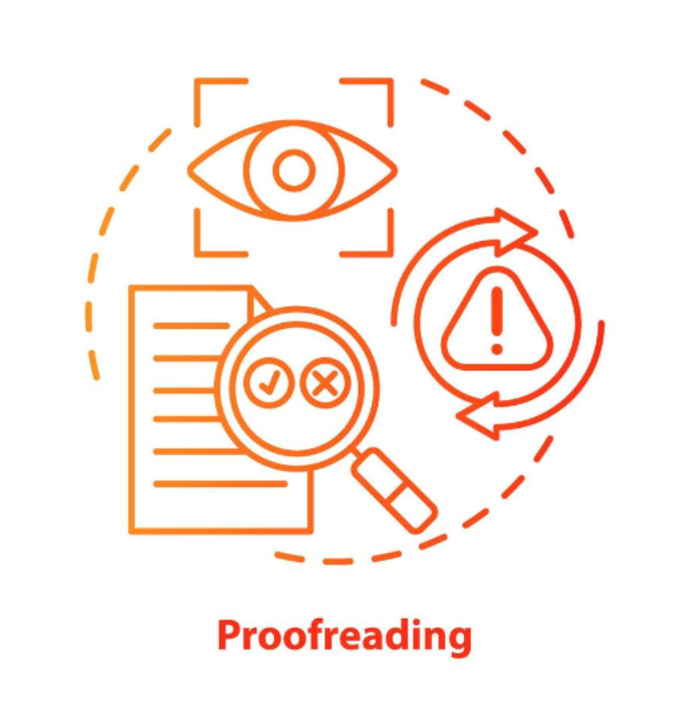
Spelling Correction and Parsing
Corrects spelling errors and enhances sentence structure using advanced models tailored for Arabic language processing.

Slide 7
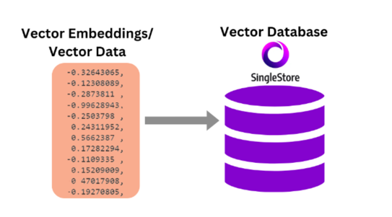
Embedding
Transforms processed Arabic text into numerical vectors that capture semantic meaning for further analysis and simulation.
Vector Database
Stores and manages embeddings, enabling fast retrieval of similar texts during character simulation.

Slide 8
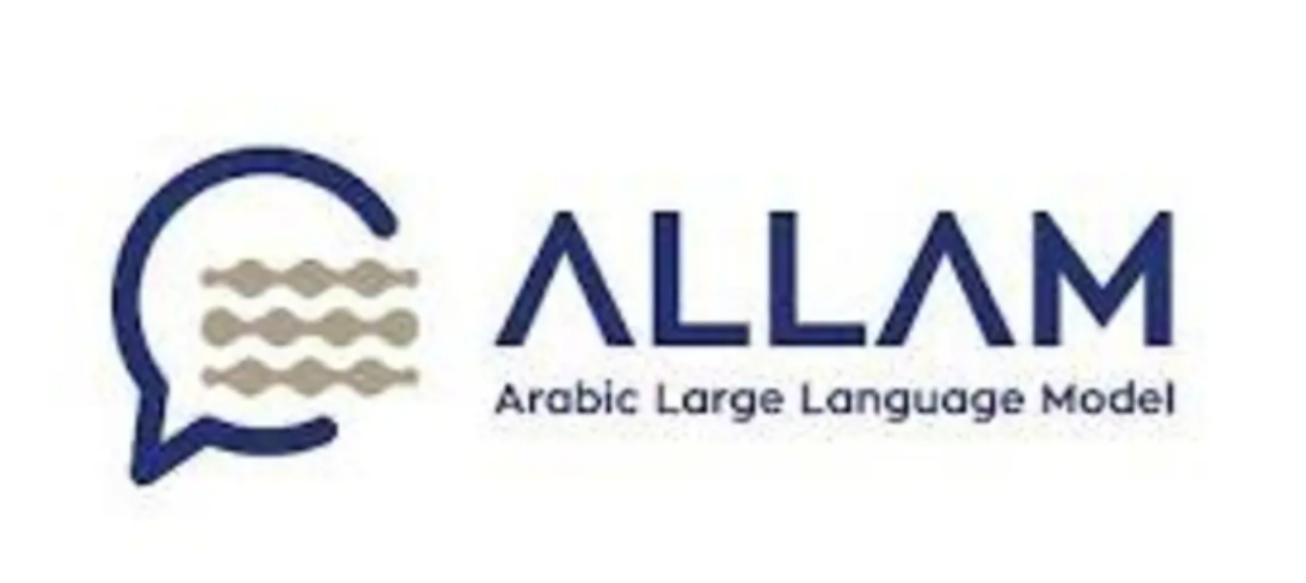
Prompt Engineering
Crafts specific inputs to guide the model in generating accurate and contextually relevant responses.
Retrieval-Augmented Generation (RAG)
Combines information retrieval with text generation to produce contextually rich and factually grounded outputs.

Slide 9

API Development
Builds a connection interface that integrates simulation functionalities into applications and systems.
User Interface (UI)
Designs an interactive dashboard that allows users to engage with simulated characters and explore historical content.

Slide 10
